Slide 1
Agile Methods – An Introduction
- Prof K G Krishna

Slide 2
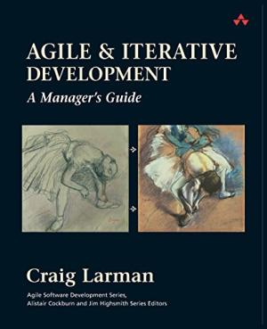


Text/Reference Books
T1
T2
Compliments of IBM
➔ As this field is evolutionary, the student is advised to stay tuned to the current and emerging practices by referring to their own organization’s documentation as well as Net sources

Slide 3
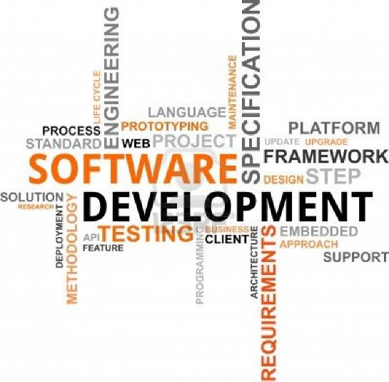
Topics
Traditional software development practices
Need for Agile Methods
Benefits of Agile Methods

Slide 4
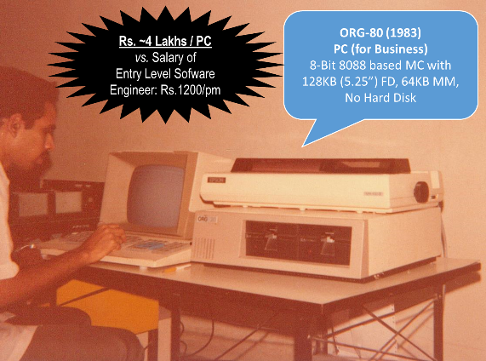
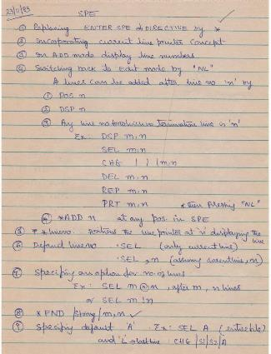
Traditional Software Development – The Backstory
Large Software Projects (Mainframe era)
Development Models based on Linear Models (Sequential/Waterfall)
No Time-to-Market Constraints (Software is Expensive)
Mostly Custom/Bespoke Software Development
Programmer-Intensive Manual Activities
K G Krishna
“A temporary endeavour undertaken to create a unique product, service, or result.” - A Guide to the Project Management Body of Knowledge (PMBOK® Guide), 4th Edition (Project Management Institute, 2008)
K G Krishna

Slide 5
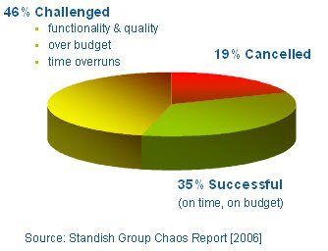
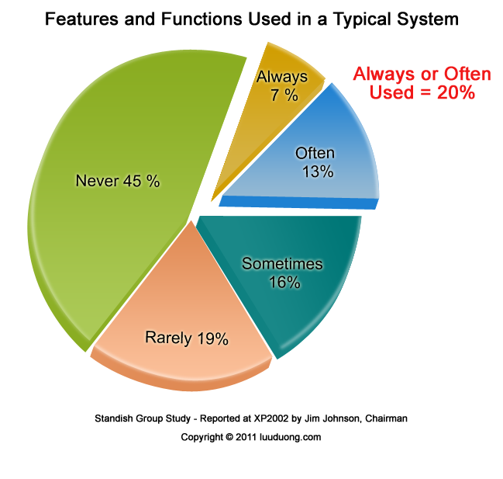
Traditional Software Projects (circa 1990 ~ 2000)
In 2009, companies and organizations in the U.S. spent $491.2billion on application development. That means that more than $103billion was wasted on failed projects.

Slide 6
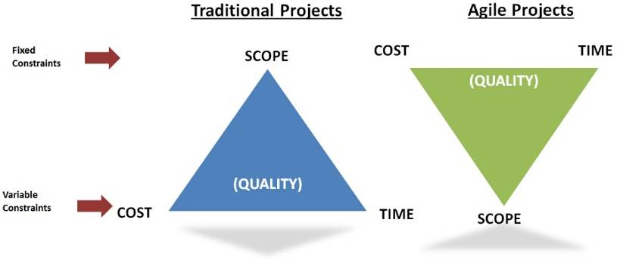
Agile Turns Upside-down Project Constraints

Slide 7
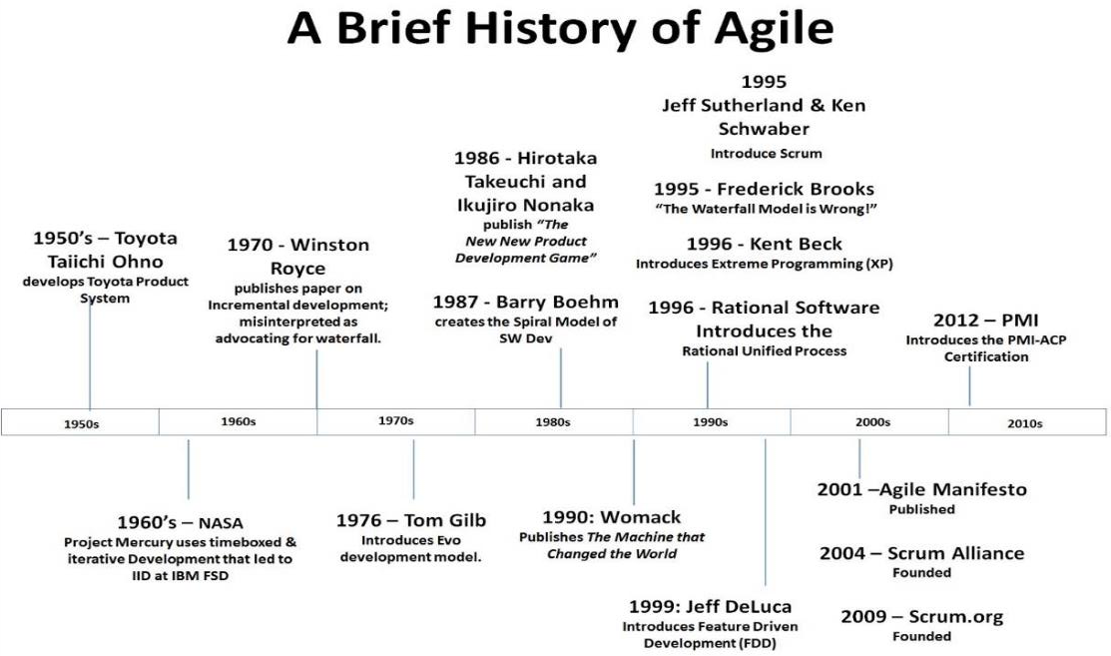
Production-Line ➔ Agile System – An Evolution
Source courtesy: (T1)

Slide 8
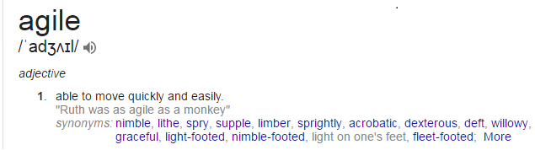
Being Agile Means…
Agility
The ability to both create and respond to change in order to profit in a turbulent business environment
Rigid Processes vs. Agile Frameworks
Being Agile = Competitive, Responsive, Flexible,…

Slide 9
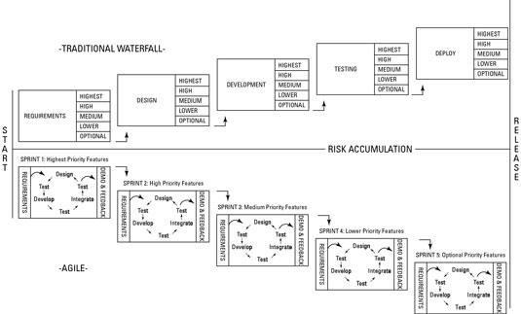
Agile Development – A Series of Short Sprints
Source courtesy: (T1)

Slide 10
Agile Development = Iterative Releases!
Agile software development is a conceptual framework for software engineering that promotes development iterations throughout the life-cycle of the project.
Software developed during one unit of time is referred to as an iteration (sprint), which may last from one to four weeks.
Agile methods also emphasize working software as the primary measure of progress

Slide 11
Need for Agile Methods ➔

Slide 12
Software Systems Today…
Changing (‘Unclear’) Requirements / Customer Demands
“Requirements will be clear only at the end of the Project”
Shrinking Development Cycles (Time-to-Market Releases)
Entrepreneurial, Innovative Apps
Shorter Shelf-life

Slide 13
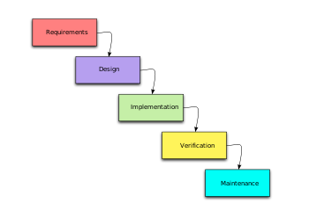
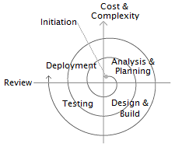
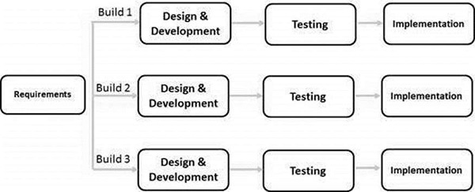
Addressing Challenges of Waterfall Model
Traditional Waterfall ➔ Adaptations of Waterfall (Incremental, Iterative Prototyping,…)
Focus on Requirements Management (Breaking down into manageable ‘Increments’)
De-risking Large Development Effort
Capturing Requirements (‘show-and-tell’, ‘prototype’ as basis of discussion around Requirements)
“Quick-and-dirty” Working Prototype to Start with

Slide 14
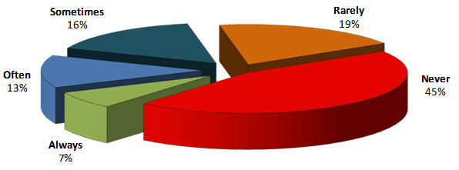
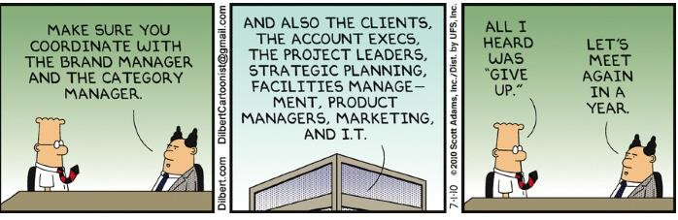
Software Feature Overload
Source: Standish Group Study, 2002

Slide 15
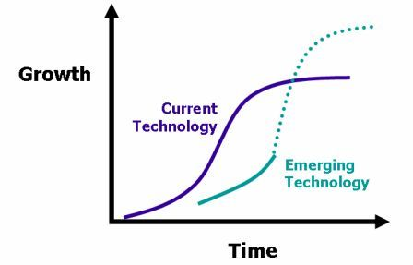
Pace of Technology vs Project Duration
Technology Life-cycles have shrunk (decade ➔ 1..2..3 years)
Bespoke Software ➔ Product Customization
Line-by-line Coding ➔ Integrated Development Frameworks

Slide 16
De-risking Future Investments Upfront…
“Fail-Safe” early rather than Failure at the end
“Proof-of-concept” when adopting new Technologies
“Testing the waters” before launching Big in the Marketplace
Today’s Software Products are strategic levers--“Idea-driven” rather than mere automation of manual process

Slide 17
Benefits of Agile Methods ➔

Slide 18
Controlled Development
Agile Products are based on empirical control method – decisions based on reality
Adjustments on-the-go by Frequent Inspections
Transparency: Everyone involved knows what is going in the project
Frequent Inspection: Regular evaluation of the Product
Adaptation: Make quick adjustments to minimize problems later

Slide 19
Agile Development ➔ Agile Project Management
Traditional Project Management Turned Upside-down!
“Let’s wait till the Project completes to see the Product” ➔ “Several Min-projects with little visible successes”
Transformation of Project Management by actively involving ALL the Stakeholders; Organization Structures & Communication; Time-Boxing of Deliveries
“Standish Group Study on Software project success and failure: In 2009, 26 percent of projects failed outright — but in 2011, that number fell by 5 percent. The decrease in failure has, in part, been attributed to wider adoption of agile approaches

Slide 20
Benefits of Agile Project Management
Almost Zero Risk of Catastrophic Project Failure
Prioritization of Business Value over ‘Good or Nice-to-have’ features
Agile Testing (Continuous Testing) ensures Problems are discovered early
Down-plays ‘Scope-creep’ as Requirement Changes are managed throughout Product Development Life-cycle
Prioritizing Features in early Iterations
Managing Evolving Requirements
Continuous Inspection and Adaptation: Improvement of Processes and Products based on Prior Experience of the ‘Completed’ Product

Slide 21
Agile Methods - Summary
Traditional Software Development Methods involving Large One-time Projects are yielding to Low-risk High-turnaround Incremental Deliverables in Agile Methods
Involvement of All Stakeholders (including Customer) early on in the Process enhances Collaboration and minimizes Scope-creep
Full Transparency and High-visibility of Deliverables in Short Iterations (Sprints)
Continuous Quality Monitoring with embedded Agile Testing across all Iterations
“Agile is the Great Leap Forward in Software Development Methodology with its associated Transformation in Agile Project Management”

Slide 22
Thank You
© Copyrights of original Authors are duly acknowledged
™ ® All Trademarks, Registered Trademarks referred in this document are the property of their respective owners

